Slide 1
Heat Exchangers
CHBE446
A review on heat exchangers for Design II
Christia Ellerman
Alissa Koniszewski
Ashfiha Rahman
Talia Ritchie
Paige Wilcox

Slide 2
Where have we seen HXs before?
Thermodynamics
Heat and Mass Transfer
Unit operations

Slide 3
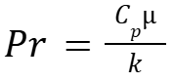

Heat Transfer Theory
Decide on Assumptions
Laminar OR Turbulent
  Laminar: Re ≦ 2300
  Transition: 2300 ≦ Re ≧ 4000
  Turbulent: Re ≧ 4000
Fully-Developed Flow
Steady-State OR Time-Dependent
Constant Thermal Properties (thermal conductivity, heat capacity)
No heat generation
Heat Transfer is in one direction
2) CHBE424 Dr. Fawole Spring 2024 Notes
Notes:
Fully developed flow: fluid’s velocity profile is constant

Slide 4


Heat Transfer Theory
Conduction
Convection
Fourier’s Law
Assumptions:
No contact resistance
Negligible Wall-Effects
Thermal Conductivity Constant
No phase change
Newton’s Law of Cooling
Assumptions:
Laminar OR Turbulent
Fully-Developed
Convection is dominant over conduction
Heat transfer coefficient constant
Negligible Heat Generation
2) CHBE424 Dr. Fawole Spring 2024 Notes

Slide 5
Heat Exchanger Theory
Flow arrangements
  Parallel flow, counter-flow
Design considerations
  Tube diameter, length, and pitch
  Shell diameter
  Baffle spacing and cut

Slide 6
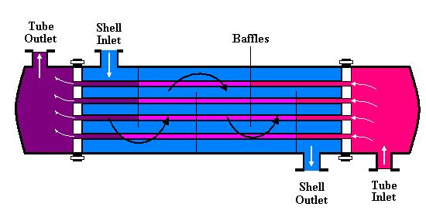


Shell & Tube
a.) https://classes.engineering.wustl.edu/mase-thermal-lab/me372b5.htm
Notes:
Baffles are usually metal plates inside the hx that direct the flow of the shell side fluid across the tube
Mention that U (overall heat transfer coefficient) will increase with turbulent flows
A is the total heat transfer surface area
Log mean temp

Slide 7
Co-Current vs. Counter-Current
Co-current: fluids enter on the same side and flow through the heat exchanger in the same direction
Counter-current: fluids enter the heat exchanger on opposite sides and flow in opposite directions (more effective heat transfer)
Example: Hot water enters a heat exchanger at 80℃ and exits at 50℃. Cold water enters the heat exchanger at 30℃ and exits at a temperature of 60℃. The mass flow rates are equal at 1 kg/s. The specific heat capacity of the water is 4184 J/kg*K. The overall heat transfer coefficient is 500 W/m^2*K and the heat exchanger has an area of 5 m^2. Find the heat transfer rate and compare the results for both co and counter current.

Slide 8
Example Solved
Co-Current
Counter-Current
When solving for log mean temp you find it is not feasible!
A negative temperature ratio is not valid (the cold fluid exit temperature cannot be hotter than the fluid outlet temperature)
Since the fluids flow in the opposite direction the log mean temperature is feasible
Q = 125.52 kW

Slide 9
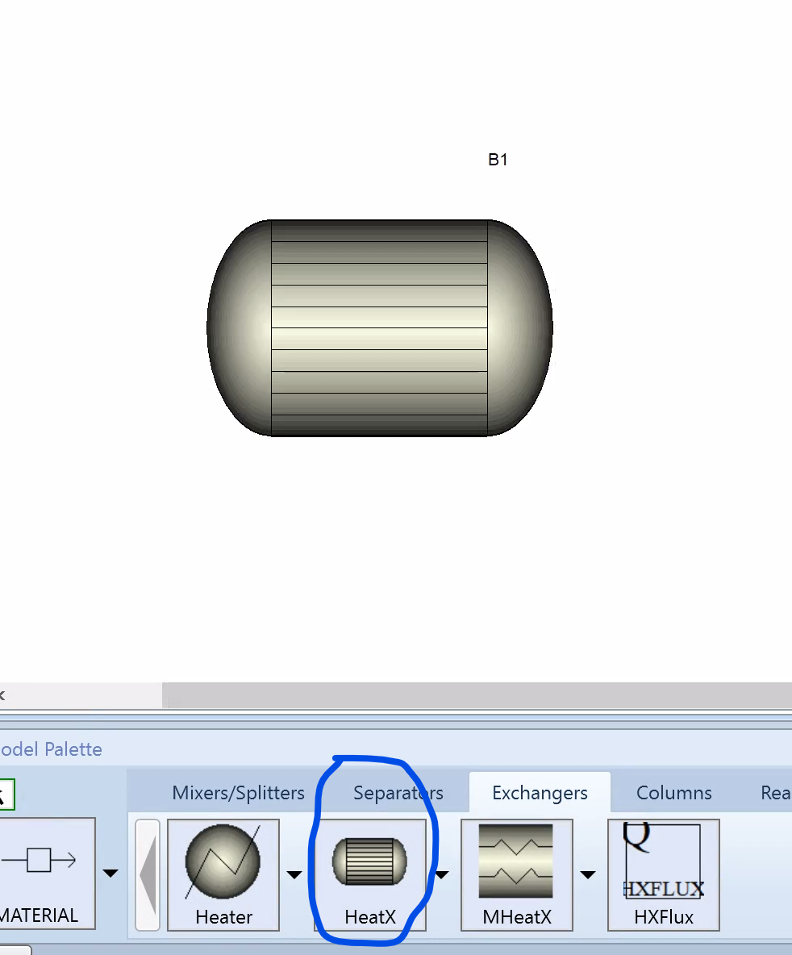
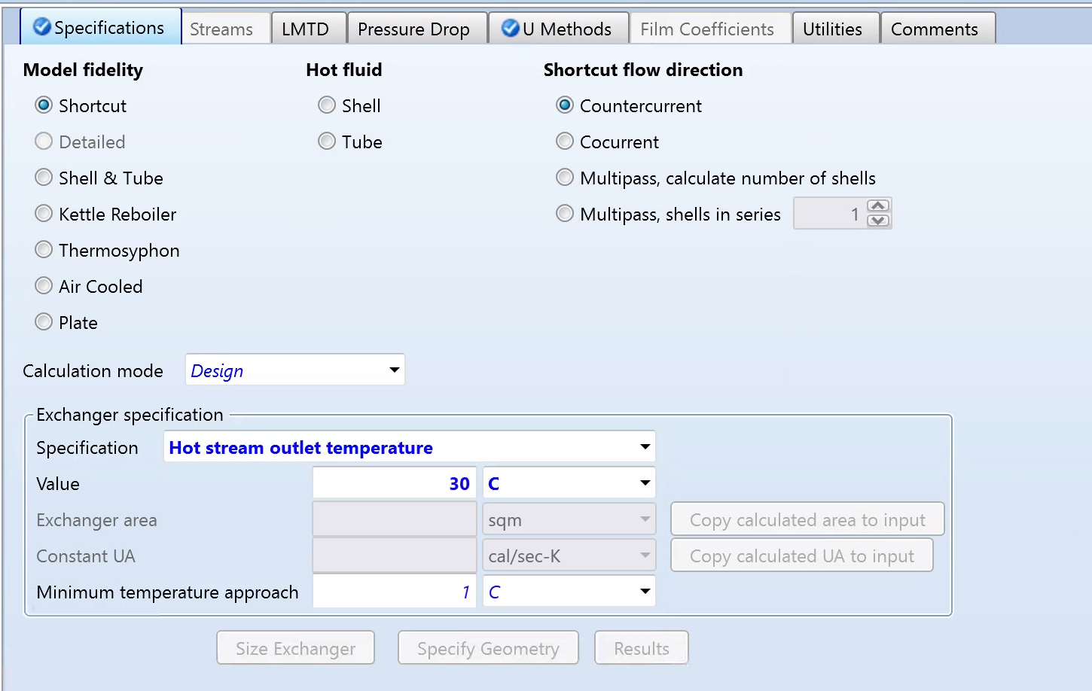
Heat Exchanger on Aspen
Simulation
Exchangers
HeatX = 2-stream countercurrent or cocurrent
MHeatX= multistream
Need to change two main things, specification( with drop down) and then input value and exchanger is set

Slide 10
Example→ Steam Reforming
Two Primary Reactions
CH4+ H2O→ CO + 3H2
CO + H2O → CO2 + H2
3) (Office of Energy Efficiency & Renewable Energy)

Slide 11
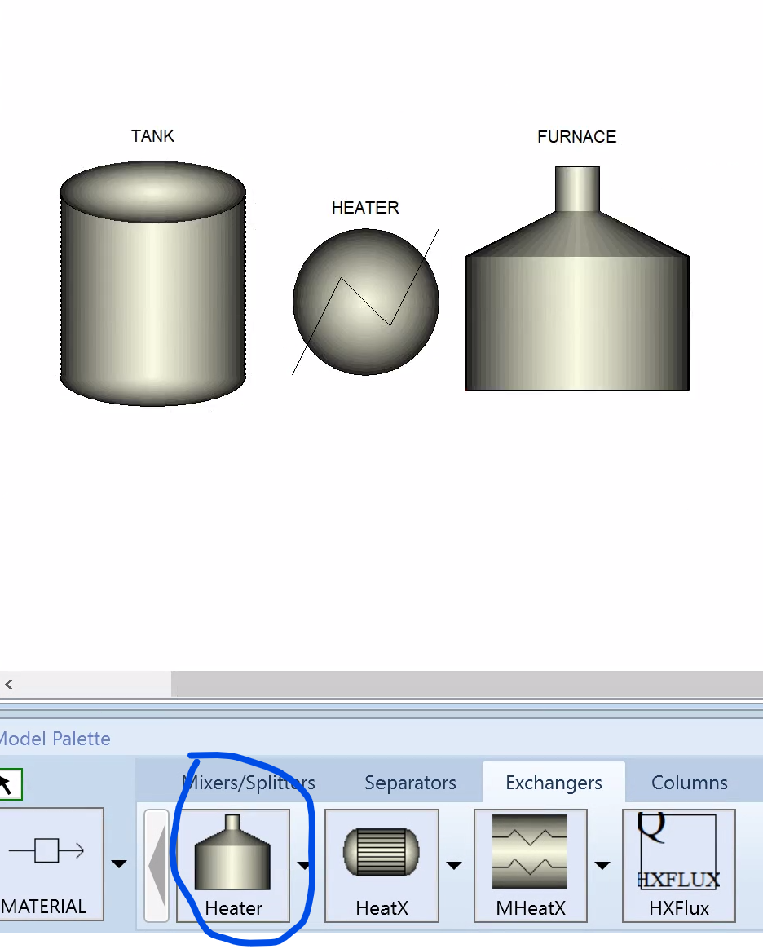
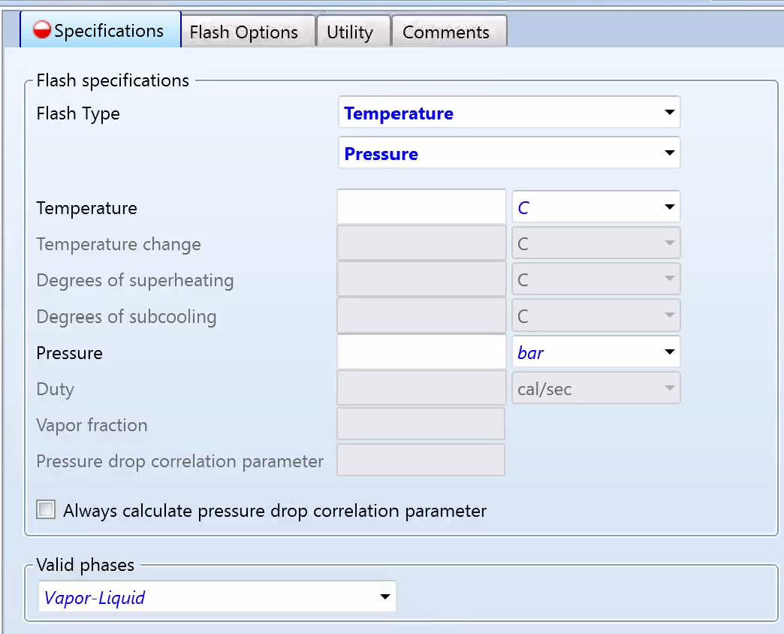
CH4 + H2O (steam) → CO + 3H2
Steam Generation
Equipment: Boiler
Questions: Temp? Size?Pressure?Time?
For common processes these can be answered through google search, your job is to optimize it.
Heat For Reaction (endothermic)
Equipment: Boiler? Furnace?
Questions: What type of fuel? Natural Gas? Propane? Time? Pressure? Temp?
Need to know two inputs
Can do flash
Can change phases
3) (Office of Energy Efficiency & Renewable Energy)
4) (Student Energy)

Slide 12
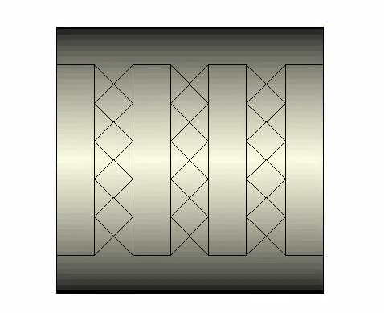
CO + H2O → CO2 + H2
Water-Gas Shift
Steps:
Feed enters HTS reactor
Gas cooled entering LTS reactor
Gas cooled again to go through separator
Equipment: Fixed Bed Reactor, Pre- Heaters, coolers, waste heat recovery units
Questions: Type of Catalyst? HX temp? Length? Pressure? Material of pipes? Valves? Gas sensors? Thermocouples?
Can’t change temp in reactor so it is important that stream is heated or cooled prior to entering for optimization, again using heater or cooler
Done through material balance stream
3) (Office of Energy Efficiency & Renewable Energy)
4) (Student Energy)

Slide 13
Applications
Oil and Gas
Chemical Processing
Power Generation
HVAC and Refrigeration

Slide 14
References
wpadmin. (2019, May 17). Shell & tube heat exchanger equations and calculations - EnggCyclopedia. EnggCyclopedia. https://enggcyclopedia.com/2019/05/shell-tube-heat-exchanger-equations/#google_vignette‌
CHBE424 Dr. Fawole Spring 2024 Notes
Office of Energy Efficiency & Renewable Energy. “Hydrogen Production: Natural Gas Reforming.” Energy.gov, 2024, www.energy.gov/eere/fuelcells/hydrogen-production-natural-gas-reforming.
Student Energy. “Steam Methane Reforming.” Student Energy, 2022, studentenergy.org/production/steam-methane-reforming/.
ChatGPT. (2025, February 2). Solving a co-current versus counter-current heat exchanger problem. OpenAI. Retrieved from https://chat.openai.com

